Slide 1
CSS for Styling

Slide 2
The good, the bad and the… ugly!
<p>
<font face="Arial">Shashdot.</font>
News for <b>nerds!!</b> You will <i>never</i>, <u>EVER</u> be
<font size="+4" color="red">BORED</font> here!
</p> HTML
Slashdot. News for nerds!! You will never, EVER be BORED here!
output
Tags such as b, i, u, and font are discouraged in strict XHTML
Why is this bad?

Slide 3
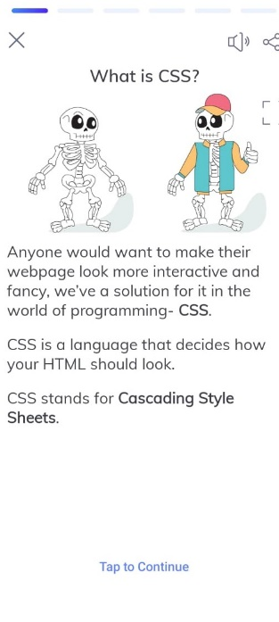
Cascading Style Sheets (CSS)
Describes the appearance, layout, and presentation of information on a web page
HTML describes the content of the page
Describes how information is to be displayed, not what is being displayed
Can be embedded in HTML document or placed into separate .css file

Slide 4
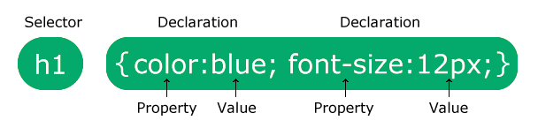
Basic CSS rule syntax
selector {
property: value;
property: value;
...
property: value;
} CSS
p {
font-family: sans-serif;
color: red;
} CSS
A CSS file consists of one or more rules
Each rule starts with a selector
A selector specifies an HTML element(s) and then applies style properties to them
a selector of * selects all elements

Slide 5
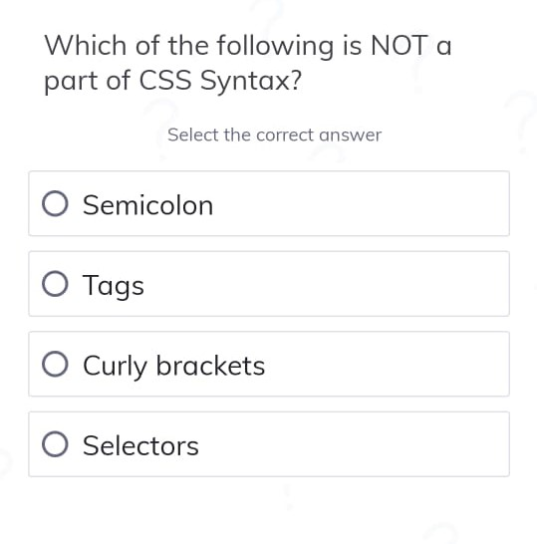
Syntax

Slide 6
Cascading Style Sheets
Properties of an element cascade together in this order:
external style sheet files (in a <link> tag)
internal style sheets (inside a <style> tag in the page's header)
inline style (the style attribute of the HTML element)

Slide 7
Attaching a CSS file <link>
<head>
...
<link href="filename" type="text/css" rel="stylesheet" />
...
</head> HTML
<link href="style.css" type="text/css" rel="stylesheet" />
<link href="http://www.google.com/uds/css/gsearch.css"
rel="stylesheet" type="text/css" /> HTML
A page can link to multiple style sheet files
In case of a conflict (two sheets define a style for the same HTML element), the latter sheet's properties will be used
Notes:
a conflict (two sheets define a style for the same HTML element

Slide 8
Embedding style sheets: <style>
<head>
<style type="text/css">
p { font-family: sans-serif; color: red; }
h2 { background-color: yellow; }
</style>
</head>
HTML
CSS code can be embedded within the head of an HTML page
Bad style and should be avoided when possible (why?)

Slide 9
Inline styles: the style attribute
<p style="font-family: sans-serif; color: red;">
This is a paragraph</p>
HTML
This is a paragraph
output
Higher precedence than embedded or linked styles
Used for one-time overrides and styling a particular element
Bad style and should be avoided when possible (why?)

Slide 10
CSS comments /*…*/
/* This is a comment.
It can span many lines in the CSS file. */
p {
color: red; background-color: aqua;
} CSS
CSS (like HTML) is usually not commented as rigorously as programming languages such as Java
The // single-line comment style is NOT supported in CSS
The <!-- ... --> HTML comment style is also NOT supported in CSS

Slide 11
CSS properties for colors
p {
color: red;
background-color: yellow;
}
CSS
This paragraph uses the style above output
property | description
color | color of the element's text
background-color | color that will appear behind the element

Slide 12
Specifying colors
p { color: red; }
h2 { color: rgb(128, 0, 196); }
h4 { color: #FF8800; } CSS
This paragraph uses the first style above
This h2 uses the second style above.
This h4 uses the third style above.
output
color names: aqua, black, blue, fuchsia, gray, green, lime, maroon, navy, olive, purple, red, silver, teal, white (white), yellow
RGB codes: red, green, and blue values from 0 (none) to 255 (full)
hex codes: RGB values in base-16 from 00 (0, none) to FF (255, full)

Slide 13
Grouping styles
p, h1, h2 {
color: green;
}
h2 {
background-color: yellow;
} CSS
This paragraph uses the above style.
output
This h2 uses the above styles.
A style can select multiple elements separated by commas
The individual elements can also have their own styles

Slide 14
CSS properties for text
property | description
text-align | alignment of text within its element
text-decoration | decorations such as underlining
line-height, word-spacing, letter-spacing | gaps between the various portions of the text
text-indent | indents the first letter of each paragraph
Complete list of text properties (http://www.w3schools.com/css/css_reference.asp#text)

Slide 15

text-align
blockquote { text-align: justify; }
h2 { text-align: center; } CSS
The Gollum’s Quote
We wants it, we needs it. Must have the precious. They stole it from us. Sneaky little hobbitses. Wicked, tricksy, false! output
text-align can be left, right, center, or justify
Notes:
justify (which widens all full lines
of the element so that they occupy its entire width)

Slide 16
text-decoration
p {
text-decoration: underline;
} CSS
This paragraph uses the style above. output
can also be overline, line-through, blink, or none
effects can be combined:
text-decoration: overline underline;

